Slide 1
Welcome To My presentation
Topic Name:Portfolio
Form
Name:Khan Md.Hasib
Lecturer ,State University Of Bangladesh
Department:CSE
TO
Name:Abu Noman Farhad
ID:UG02-48-18-009
Batch :48th
Department :CSE

Slide 2
Objects Of Portfolio
1.Definition Portfolio
2.Type Portfolio
Features
1.Home
2.About
3.Education
4. Achievement
5.Blog
6.Contact
Overview

Slide 3
What Is Portfolio?
A range of Investments Held by a person or Organisations

Slide 4
Type Of Portfolio
Three Type
1.A ShowCase Portfolio
2. Assessment Portfolio
3.A Development Portfolio

Slide 5
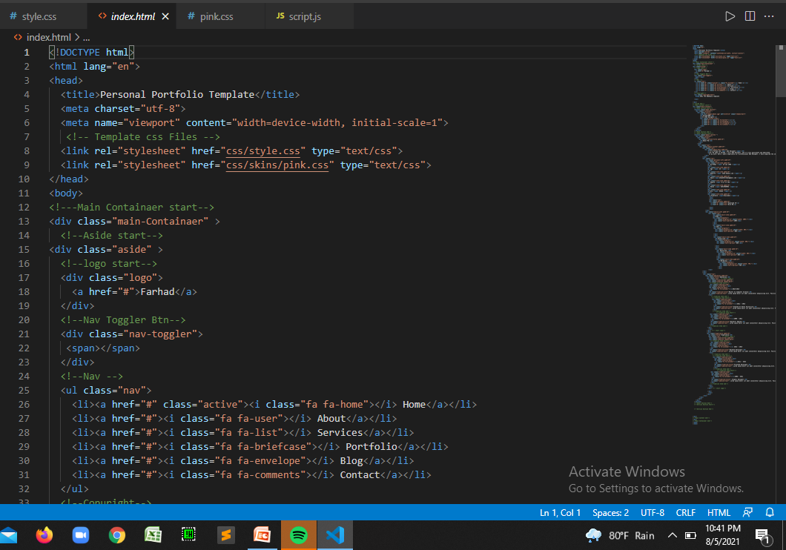
Html-Code

Slide 6
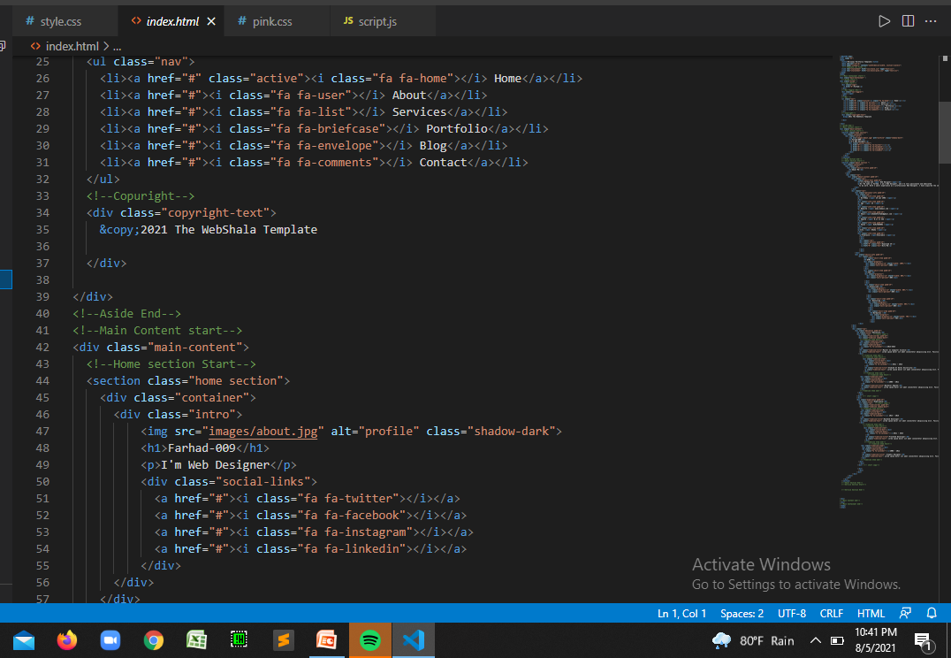

Slide 7
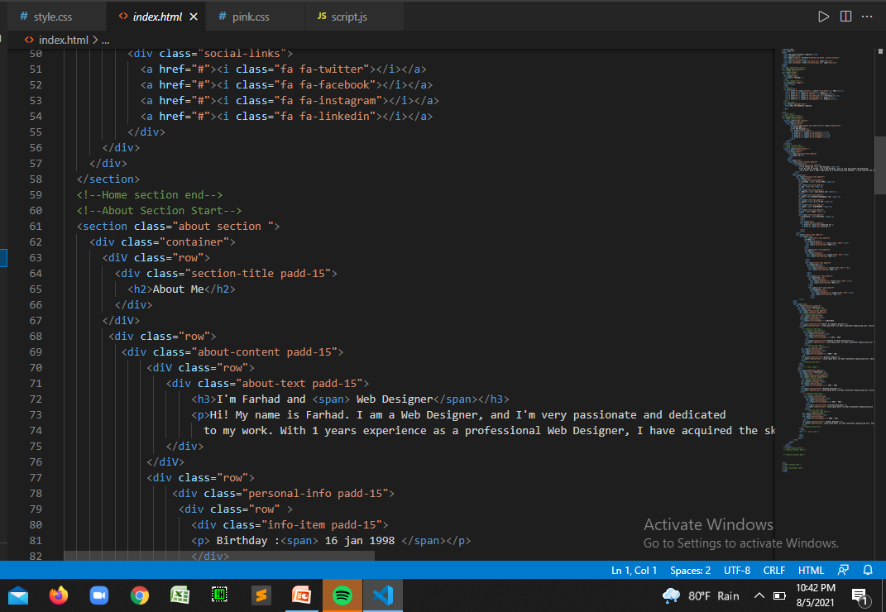

Slide 8
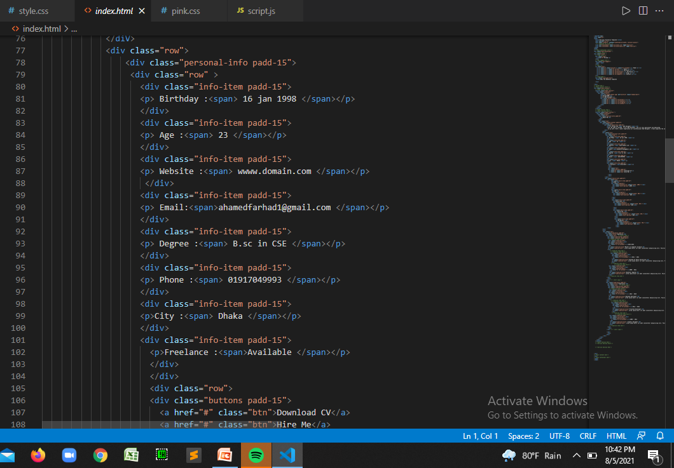

Slide 9
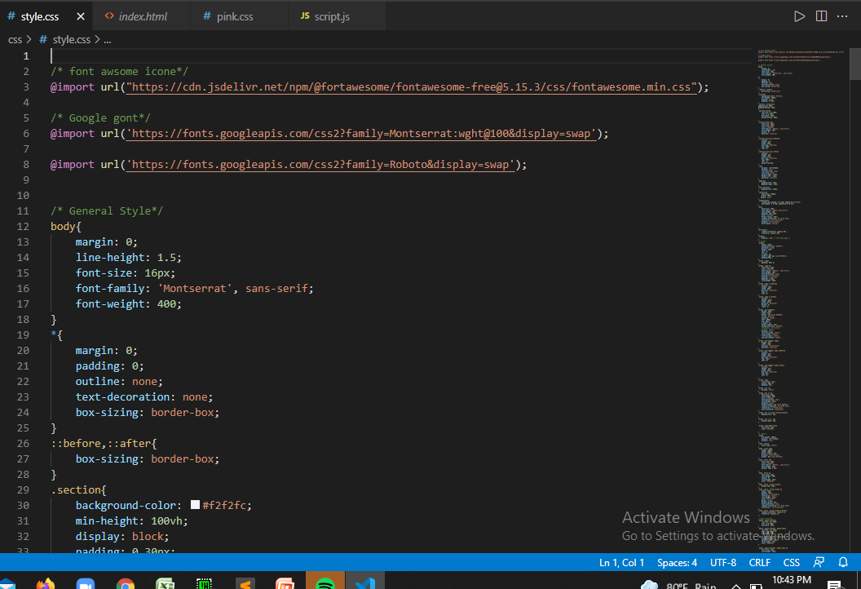
CSS-Code

Slide 10
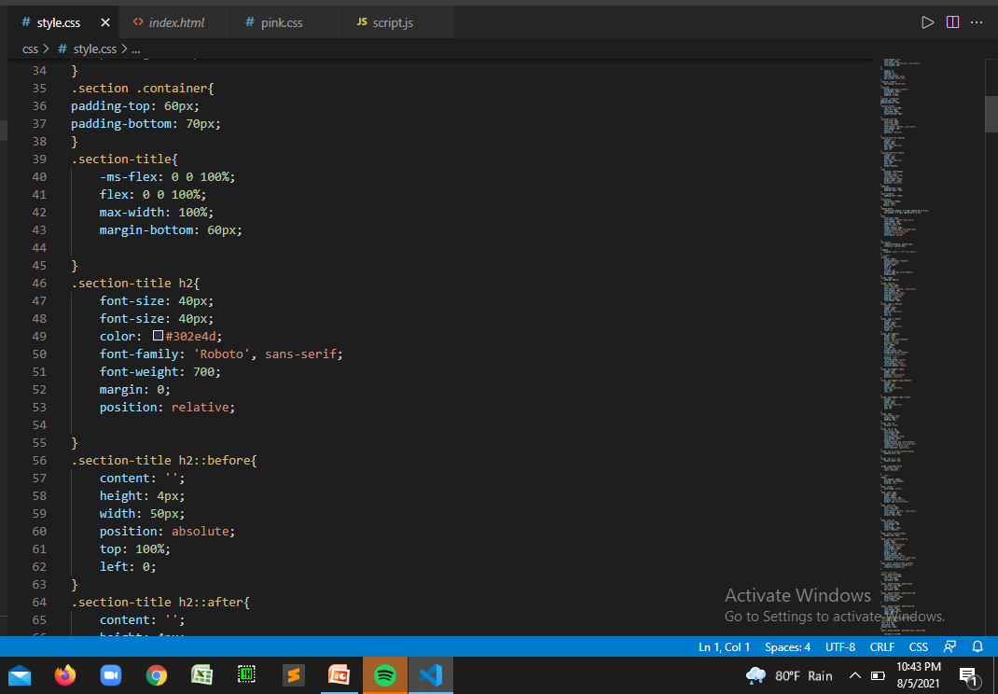

Slide 11
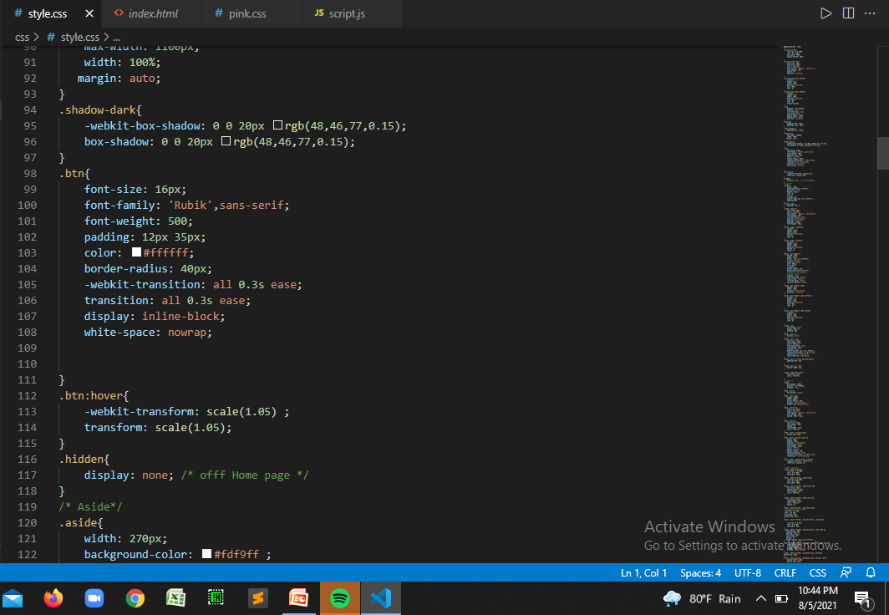

Slide 12
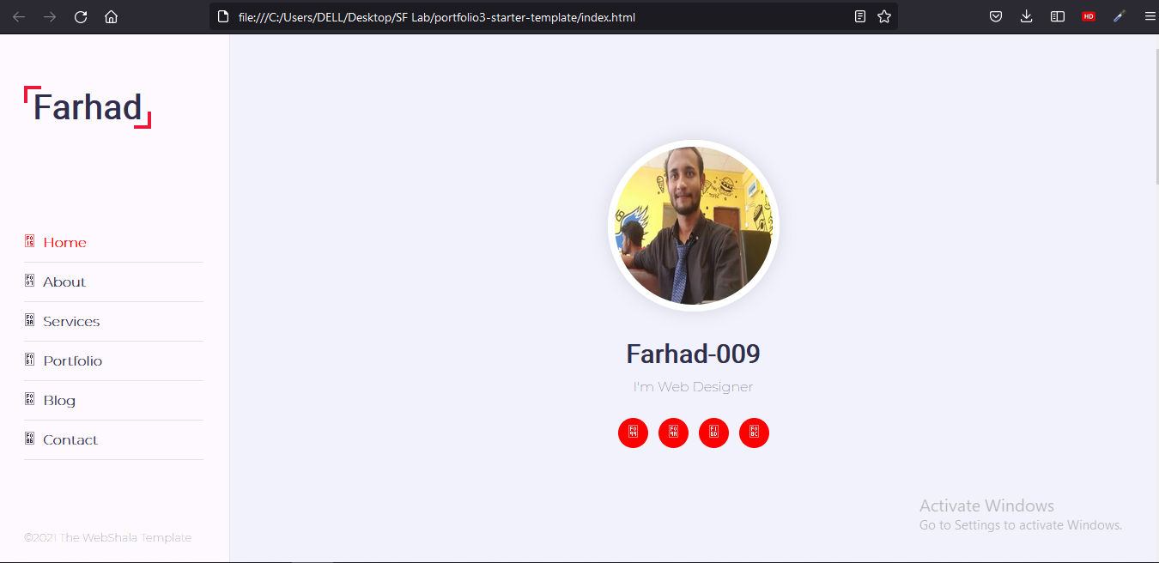
Features

Slide 13
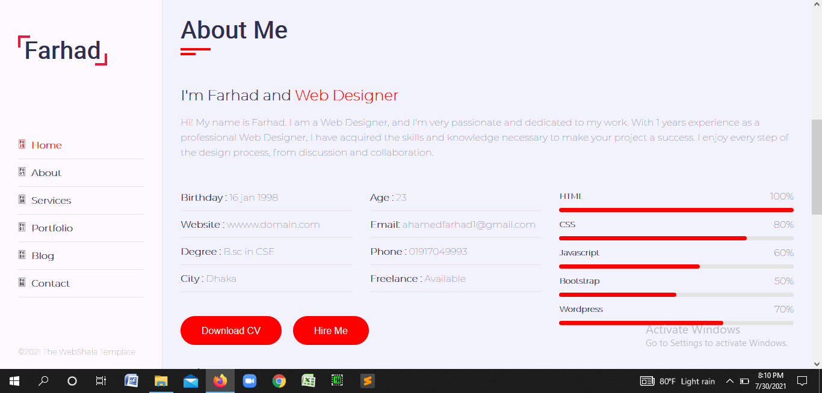

Slide 14


